Slide 1
Transportation & Health A Collision Course for a Better Tomorrow
Joseph Marek, PE, PTOE
Clackamas County Traffic Engineering
Clackamas Safe Communities
H
T
Oregon ITE Winter Workshop February 26, 2015

Slide 2
Process
Road Safety Audit
Health Impact Assessment
Conclusions/Recommendations

Slide 3
RSA/HIA
Road Safety Audit
Ped/Bike safety of a 5-lane arterial
3 intersections
Qualitative risk scale
Health Impact Assessment
Direct & indirect health impacts of RSA
Gaps/Opportunities to address health
HIA Score
T
H

Slide 4
Road Safety Audit
RSA
A formal safety performance examination of an existing or future road or intersection by an independent, multidisciplinary team
Qualitatively estimates and reports on potential road safety issues and identifies opportunities for improvements in safety for all road users.

Slide 5
Health Impact Assessment
HIA
A structured process that uses scientific data, professional expertise, and stakeholder input to identify and evaluate public health consequences of proposals
Suggests actions that could be taken to minimize adverse health impacts and optimize beneficial ones
Source: “Improving Health in the United States: The Role of Health Impact Assessments” by the National Research Council, September 2011

Slide 6
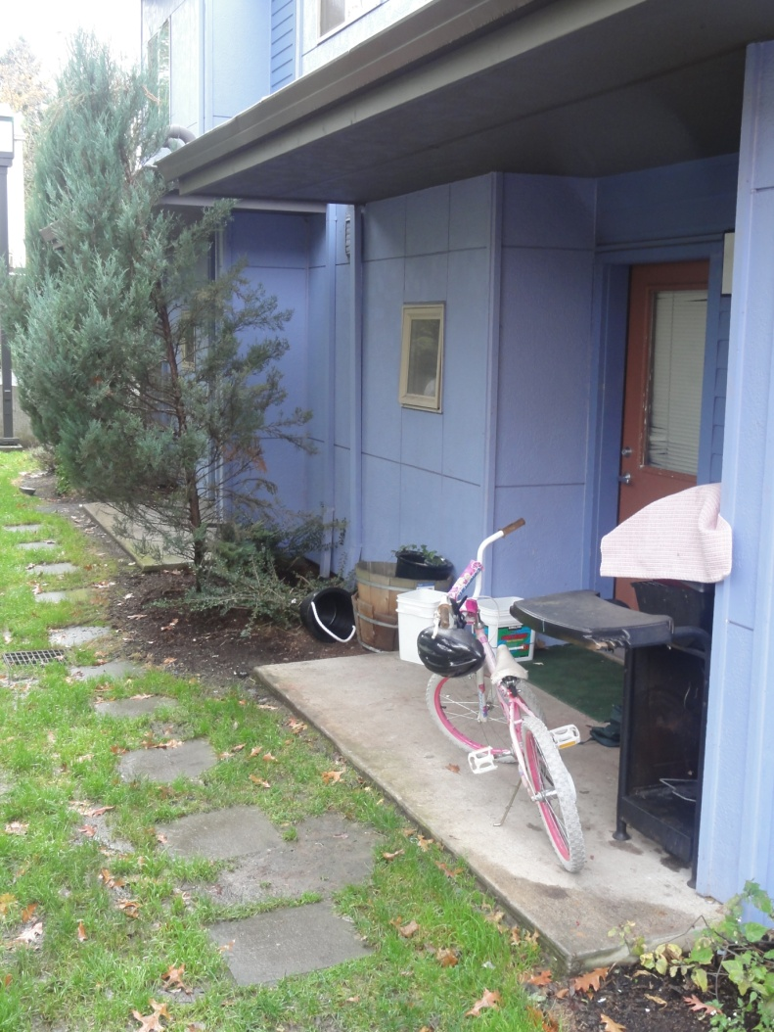
Health: A complete state of physical, mental, and social well-being and not just merely the absence of disease or infirmity
World Health Organization, Health Promotion Glossary,1999

Slide 7
Health Equity
Refers to disparities between population groups in the presence of disease, health outcomes.
Is impacted by a variety of changeable social factors such as income inequality, educational quality, natural and built environmental conditions, individual health behavior choices, and access to health care.
Is improved as these disparities are eliminated or minimized. Health inequity is exacerbated as these disparities grow.

Slide 8
Health Determinant: The range of personal, social, economic and environmental factors which determine the health status of individuals or populations.
Examples:
Behavioral determinants: consumption of fruits and vegetables, physical activity, smoking
environmental determinants: convenient access to healthy food retail, air quality, traffic infrastructure

Slide 9
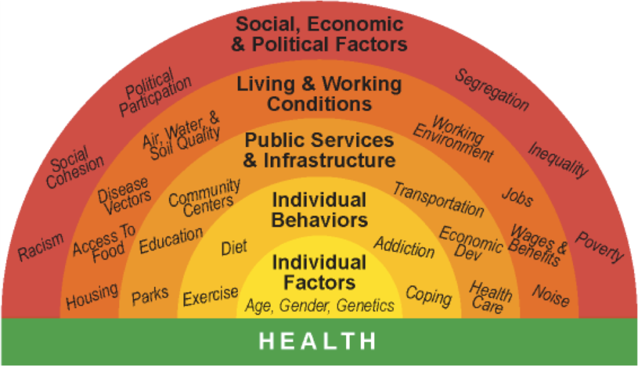
HIA asks …
How does the proposed
project, plan, policy
and lead to health outcomes
affect

Slide 10
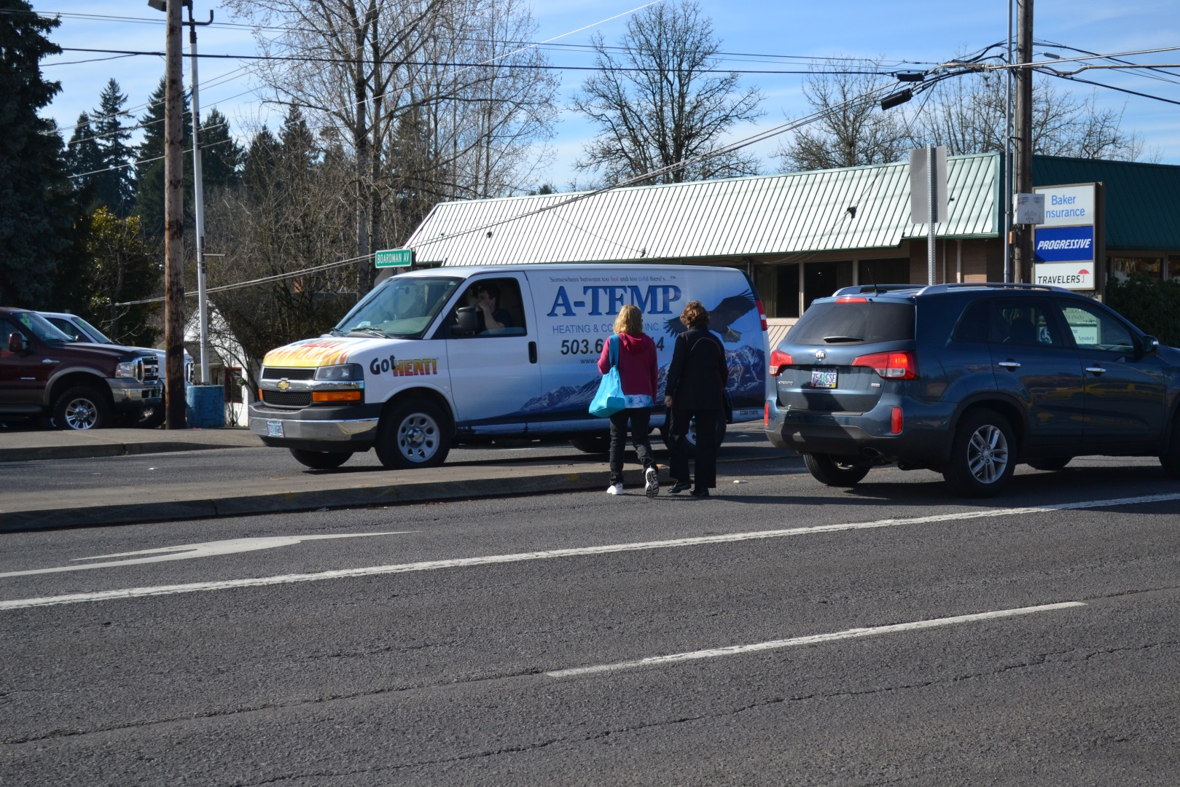
Health Outcome: Health status of an individual, group or population which is attributable to a number of determining factors such as behaviors, social and community environments, health care services, and genetics.
Examples:
Depression, diabetes, physical injury, asthma, premature death

Slide 11
Health Pathways

Slide 12
Indicators

Slide 13
Questions Asked
Access to physical activity
Access to resources
Healthy food
Schools/jobs
Transportation
Exposure to:
Air pollution & Noise
Transportation equity

Slide 14
HIA/RSA Scoring
RSA - Fix Scores
Solution 1 C
………. 2 D
……….. 3 E
……….. 4 C
………. 5 D
……….. 6 E
HIA – Fix Scores
Solution 1 E
………. 2 D
……….. 3 C
……….. 4 C
………. 5 E
……….. 6 C
J
Creates different way to look at & prioritize solutions

Slide 15
Perspectives
Incorporating health into our work
Changes our lens on our view of the transportation system
More holistic approach
Fits in very well with County values/priorities

Slide 16
Connections!

Slide 17
System Users = People
People have certain risk tolerances
Do our designs and processes truly match the risk tolerance of the users?

Slide 18
Homework!
Recognize health connections
Integrate health into our planning/engineering work
We already impact health – let us make sure it is positive!
Health
Mobility
Accessibility
Equity

Slide 19
Learning!
Have more discussions
Talk with our clients
Change our lens!
We can have a positive impact

Slide 20
References
http://www.ite.org/activeliving/index.asp
http://www.cdc.gov/healthyplaces/healthtopics/transportation/practice.htm
http://activelivingresearch.org/

Slide 21
Traffic Safety Starts with You
Questions?
Joseph Marek
JoeM@clackamas.us
503.742.4705
Visit Us
www.ClackamasSafeCommunities.org

