Slide 1

Pedestrian Responsive Signal Timing Strategies
Oregon ITE Winter Workshop
February 26th, 2015
Sirisha Kothuri, Chris Monsere, Andy Kading - PSU
Peter Koonce, Ty Reynolds – PBOT
Ed Smaglik, Chris Sobie - NAU

Slide 2
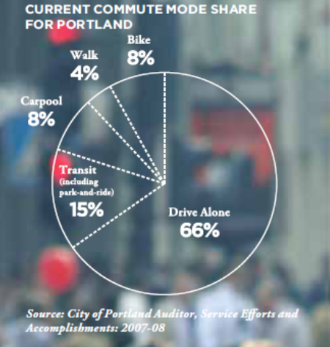
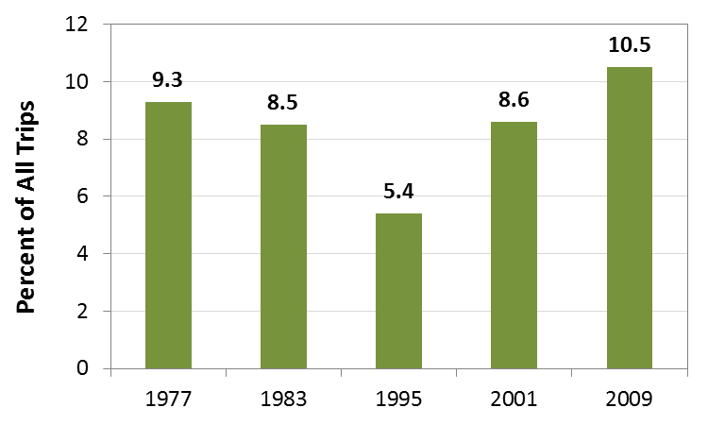
Introduction
Growing emphasis on active transportation
Walking healthy, livable communities
Increase in walking trips
National Walking Trends
Local Commute Shares - Walk 4%
Source: Data from Pucher et al.,(2011)
Source: City of Portland, Climate Action Plan
Introduction| Motivation| Findings| Next Steps

Slide 3
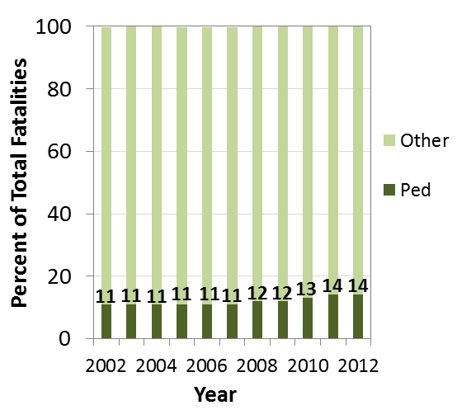
Introduction
Pedestrian fatalities
  73% - urban areas
  20% - intersections
Poor crossings
  Deter people from walking
  Unsafe crossing behavior
“On average, a pedestrian was killed every 2 hours and injured every 7 minutes in traffic crashes”
Fatality Trends
Source: NHTSA, Traffic Safety Facts 2012
Introduction| Motivation| Findings| Next Steps

Slide 4
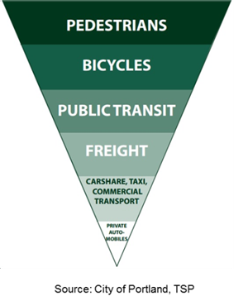
Motivation
Delays affect pedestrians disproportionately
“Everyone is a pedestrian”
Increasing Priority
How do we translate “pedestrian first” policies into specific operational strategies at intersections?
Introduction| Motivation| Findings| Next Steps

Slide 5
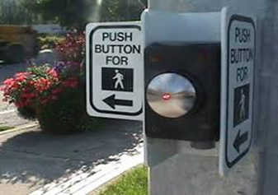
Completed Research
Exploring Pedestrian Responsive Signal Timing Strategies in Urban Areas
  Impacts of change in signal controller mode of operation on ped delay and overall delays
  What traffic regimes are best suited?
  Impact of increased permissive length on ped delay
  Guidance on change in mode of operation based on field data
Introduction| Motivation| Findings| Next Steps

Slide 6
Strategies
Introduction| Motivation| Findings| Next Steps

Slide 7
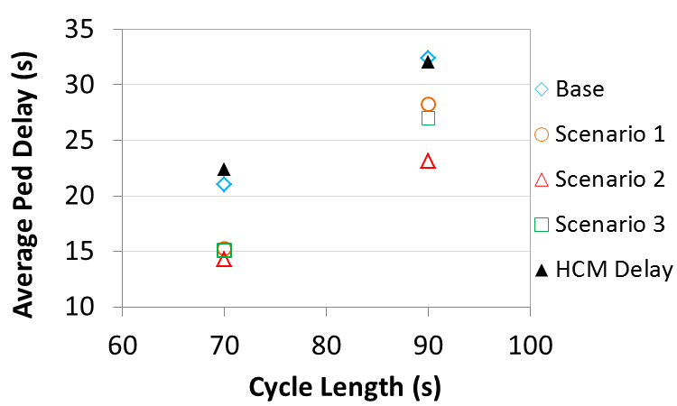
Increase in Permissive Length
Introduction| Motivation| Findings| Next Steps

Slide 8
Research in Progress
Improving Walkability Through Control Strategies at Signalized Intersections
  Newer treatments (LPI, scramble) improve safety, but peds must still wait their turn
  Can result in delays much longer than those for vehicles
  Are there opportunities to improve operations through control strategies?
Slide Credit: E. Smaglik
Introduction| Motivation| Findings| Next Steps

Slide 9
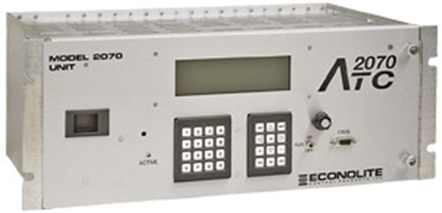
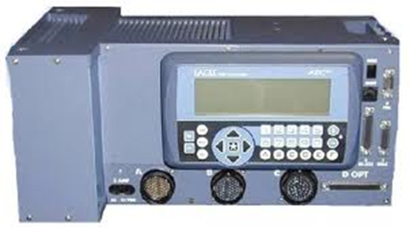
Research in Progress
Two step approach
  SITL simulation of various ped control treatments to identify when to implement different strategies
    Shorter cycle lengths
    Elimination of coordination during certain periods
    Leading pedestrian intervals
    Pedestrian priority
  Field implementation of pedestrian priority with 2070 and NEMA controllers
    Portland, OR
    Flagstaff and/or Mesa, AZ
Slide Credit: E. Smaglik
Introduction| Motivation| Simulation| Next Steps

Slide 10





Thank you!
Contact Information
Sirisha Kothuri, PhD
Post Doctoral Research Associate
Civil and Environmental Engineering
Portland State University
Email: skothuri@pdx.edu
Phone: 503-725-4208

Slide 11
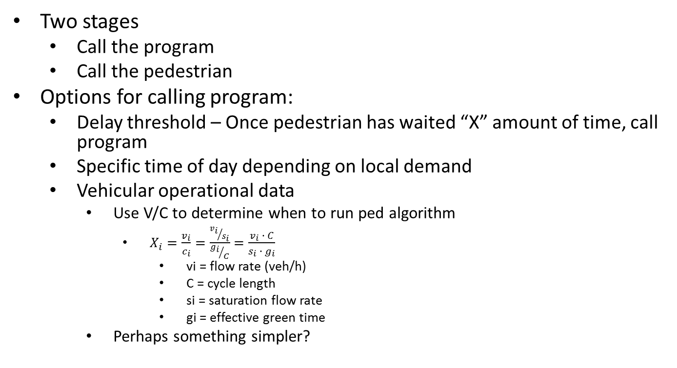
Pedestrian Priority Algorithm
Two stages
  Call the program
  Call the pedestrian
Options for calling program:
  Delay threshold – Once pedestrian has waited “X” amount of time, call program
  Specific time of day depending on local demand
  Vehicular operational data
    Use V/C to determine when to run ped algorithm
      $X_{i}=\frac{v_{i}}{c_{i}}=\frac{{v_{i}}/{s_{i}}}{{g_{i}}/C}=\frac{v_{i} ∙ C}{s_{i} ∙ g_{i}}$
        vi = flow rate (veh/h)
        C = cycle length
        si = saturation flow rate
        gi = effective green time
    Perhaps something simpler?
Slide Credit: E. Smaglik
Introduction | Motivation | Simulation| Next Steps

