Slide 1
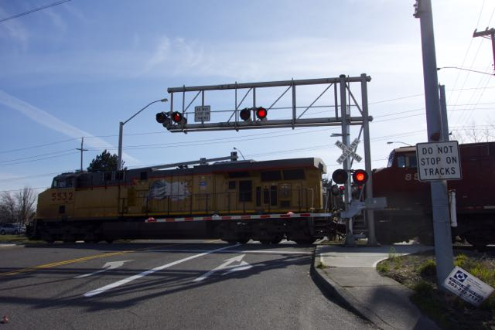
A Method to Verify Railroad Interconnect with Highway Traffic Signal Systems
Adam Moore
Portland Bureau of Transportation
Oregon ITE Winter Workshop
February 26, 2015

Slide 2
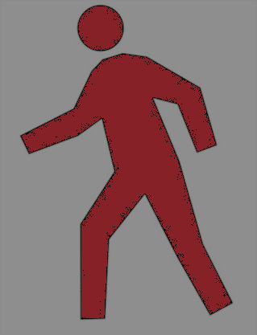
Railroad Advance Warning Time
Notification of approaching train forwarded to highway traffic signal controller
Interconnected crossing
Terminate red phases and associated ped movements
Bring up green phases and hold until gates are down
Allow only phases that do not conflict with crossing until preemption ends
<200 ft
Notes:
A train approaching a rail crossing initiates a sequence of events designed to clear the right-of-way. At crossings close to signalized intersections, the advance warning sequence must involve the traffic signal controller, to ensure vehicles in the right-of-way are allowed to clear. These intersections are called interconnected crossings, and they work by terminating the phases in red, bringing up the green phase, and… … Crossings within 200 feet of a signalized intersection are REQUIRED to be interconnected.

Slide 3
Interconnected Crossing Warning Activation Sequence
GENERATED BY RAILROAD
Ped Clear
Veh Advance Preemption
Gates Down
Train in Crossing
“Island Circuit”
Already collected by UPRR
Integrated into traffic controller event log
Notes:
The interconnected crossing warning activation sequence is initiated on the railroad’s end. As the train approaches, it first sends the signal controller a pedestrian clear-out interval alarm, indicating the controller should bring up the flashing don’t walk for the conflicting pedestrian crossing. Next is the vehicle advance preemption alarm, indicating the controller should end all conflicting vehicle movements and allow vehicles to clear the right-of-way. Next is a notification that the gates are down (horizontal). Finally, and this is the novel portion of this project, is the alarm that the train is physically in the crossing. Called an “island circuit,” this alarm is collected by UPRR, but now we are also collecting it in the signal cabinet.

Slide 4
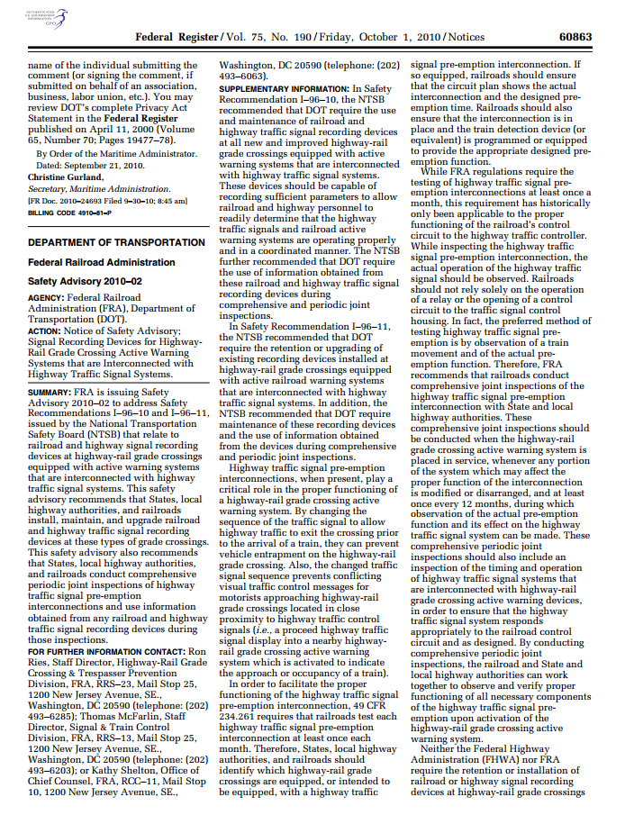
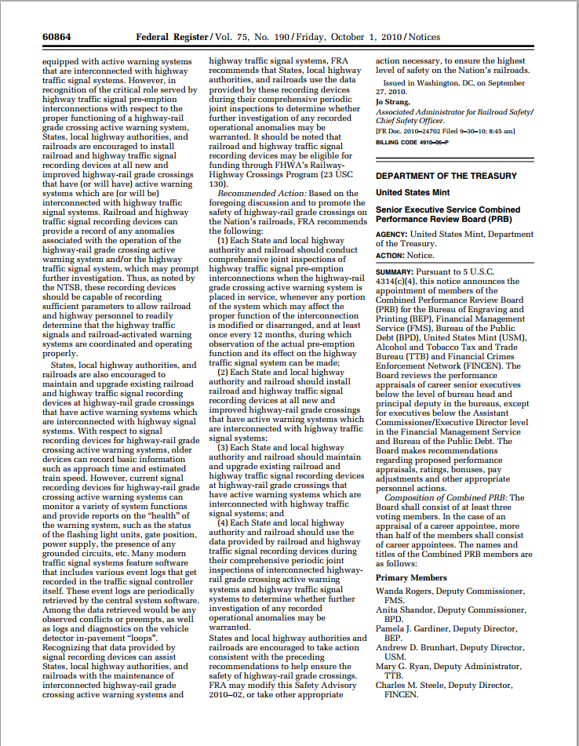
Safety Advisory 2010-02
“Authorities should install, maintain, and upgrade railroad and highway traffic signal recording devices at interconnected crossings.”
“Modern traffic signal systems can record event logs.”
Notes:
These and other alarms are generated at every interconnected crossing when a train passes. Somewhat rarely, however, are they actually recorded and archived. That’s changing, thanks to a Federal Railroad Administration recommendation in 2010 that agencies record the crossing data. The FRA even notes that modern controllers can log the data!

Slide 5
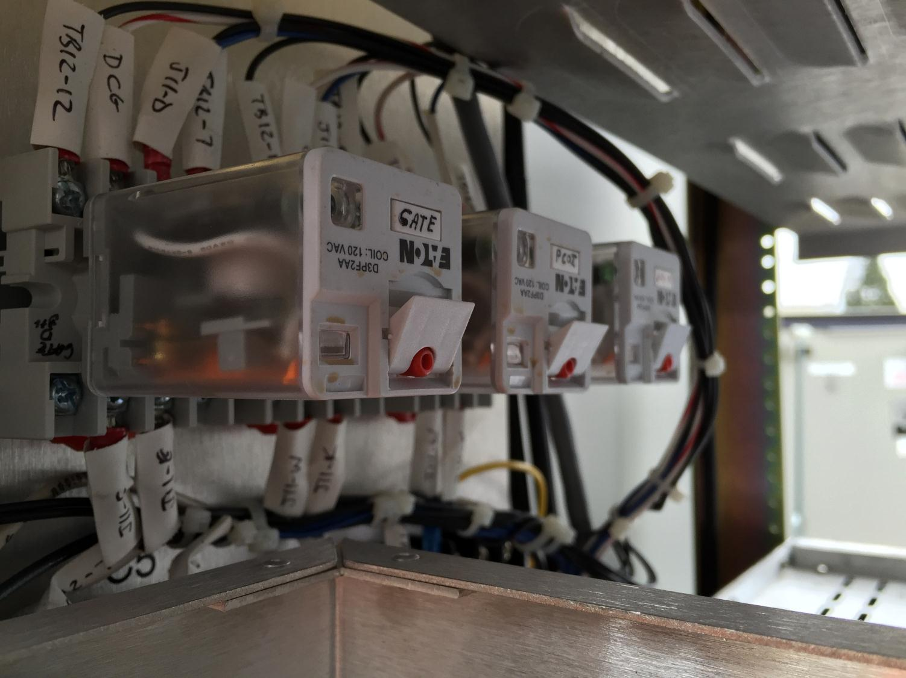
Signal Cabinet Hardware
Vehicle Advance Preemption
Gate Down
Ped Clear
Notes:
It’s a fairly simple setup process. A few additional relays inside the signal cabinet, a few extra cards. Nothing extraordinary as far as cabinet wiring goes.

Slide 6
Advantages of Recording
Verification of interconnection functionality,
per SA 2010-02
Event log of crossing trends and anomalies
Timing optimizations
Notes:
Advantages of recording are many. Verify the interconnection and cross-agency (highway and railroad) collaboration. Log crossing trends and anomalies. Optimize alarm sequences and controller timing.

Slide 7
Interconnected Crossing Warning Activation Sequence
Ped Clear
Veh Advance Preemption
Gates Down
Train in Crossing
Notes:
I mentioned that the alarms are generated by the railroad. We also generate an alarm.

Slide 8
Interconnected Crossing Warning Activation Sequence
GENERATED BY TRAFFIC CONTROLLER
Ped Clear
Veh Advance Preemption
Veh Green
Gates Down
Train in Crossing
Notes:
The “vehicle green” alarm indicates when the conflicting phase is served a green light. This is generated by us and shared with the railroad to let them know vehicles are clearing the tracks.

Slide 9
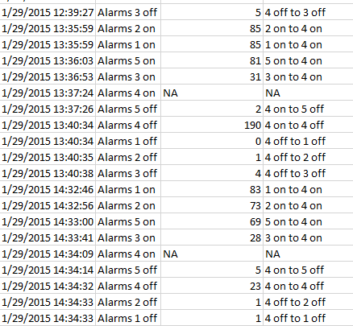
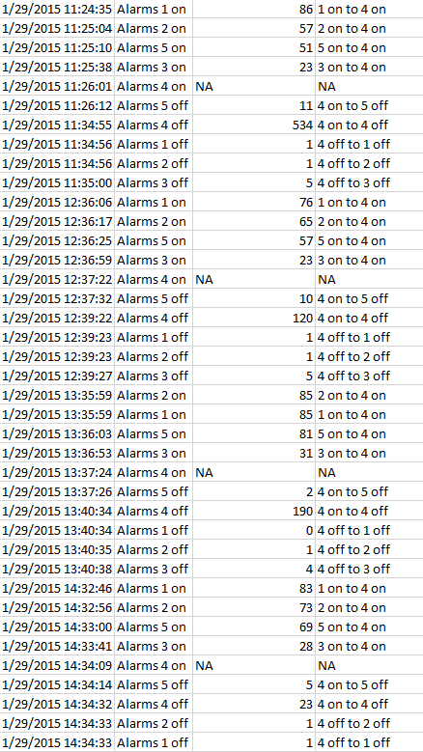
Warning Sequence Archiving
Ped Clear
On/Off
Veh Advance Preemption
On/Off
Veh Green
On/Off
Gates Down
On/Off
Train in Crossing
Train in Crossing
On/Off
On/Off
Notes:
Together, these alarms are logged and archived on our central server, giving us a wealth of information. But the most important thing is having the island circuit, the train in crossing notification. From this we can benchmark each of the other alarms.

Slide 10
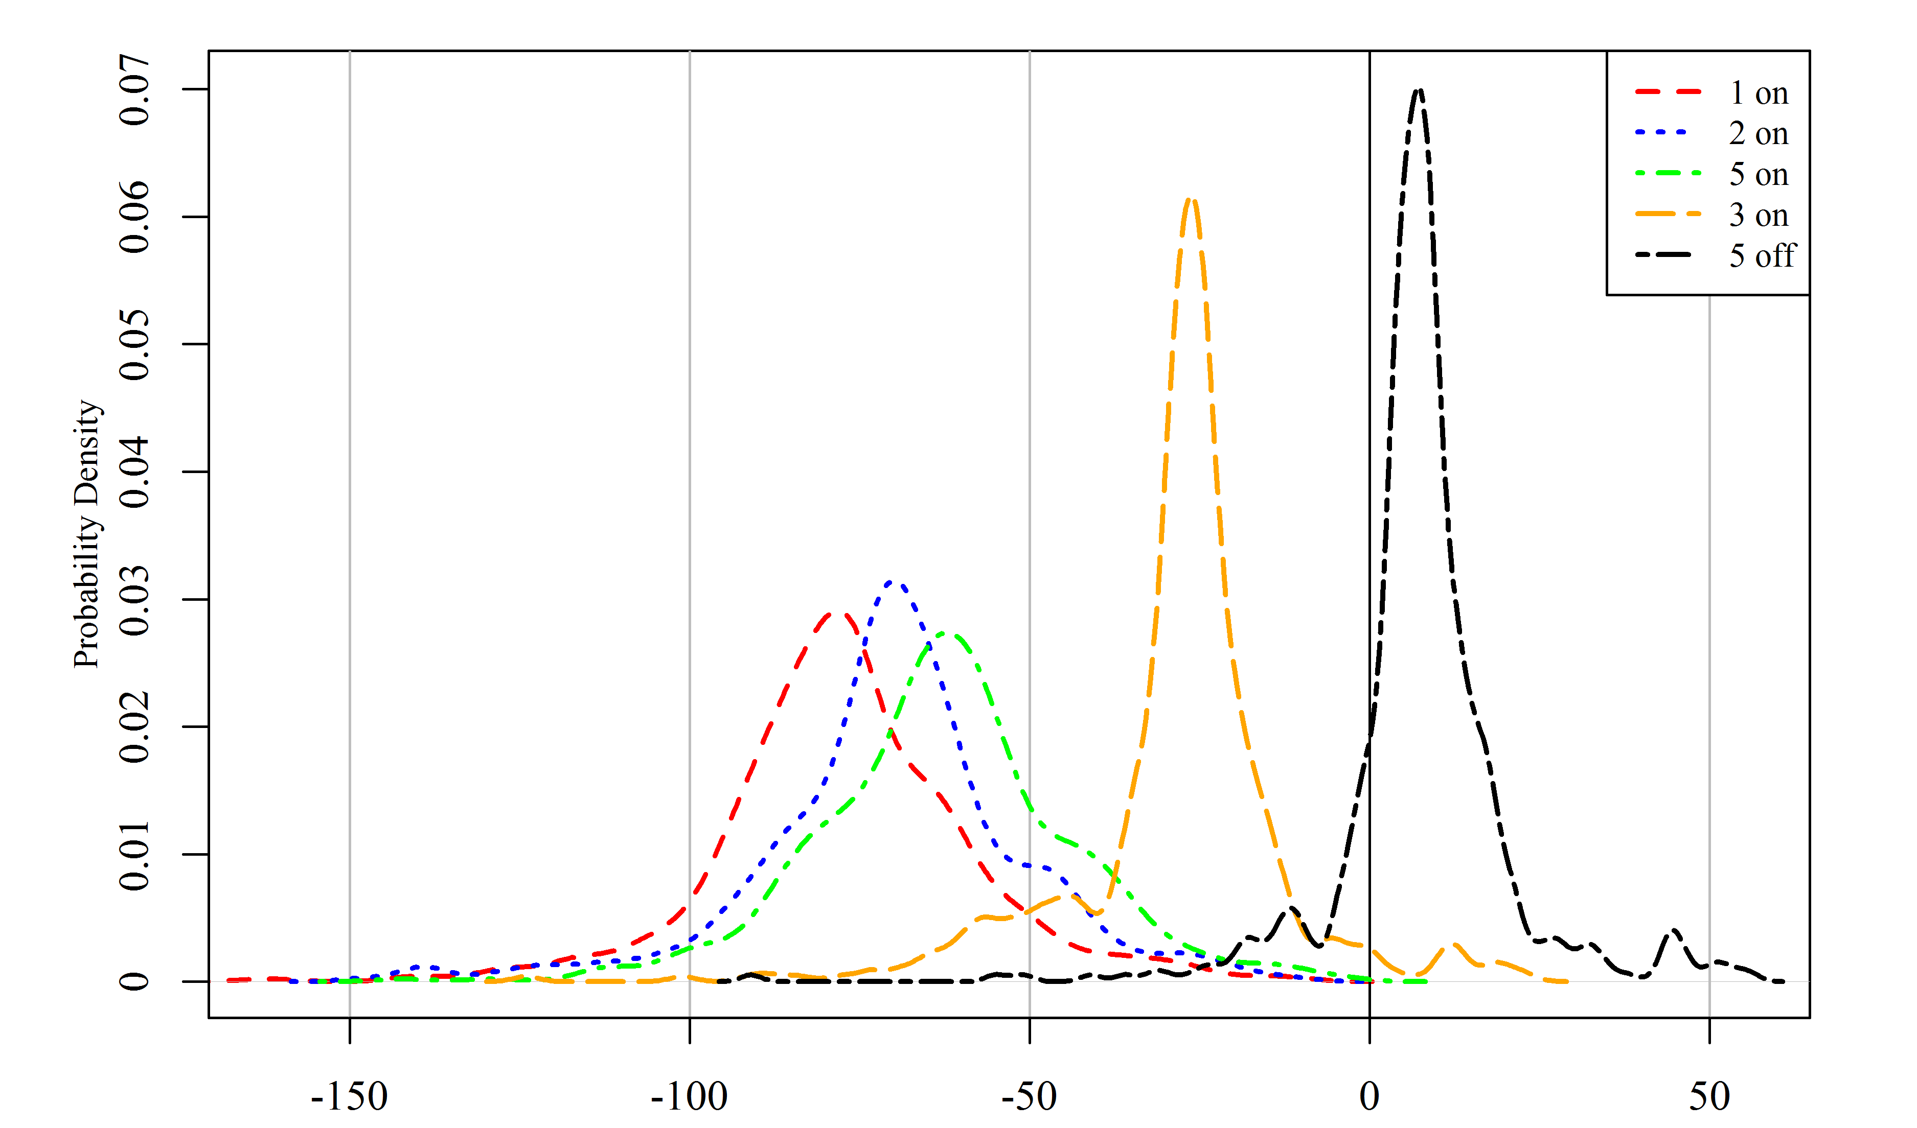
Rail Crossing Event Data Streams
Veh Green Off
Gate Down
Veh Green On
Veh Advance PE
Ped Clear
Seconds Relative to Train Arriving in Crossing
SE 11th Ave/SE Milwaukie Ave & SE Gideon St
Notes:
Here’s an example of what we’re able to see: the likelihood of alarm occurrences relative to the train arriving in the crossing. You can see the spread at this particular intersection. It’s a unique intersection near UPRR’s Brooklyn railyard, so we see a lot of switching movements and uncommon activity. Still, you can see the peaks for where the alarms occur.

Slide 11
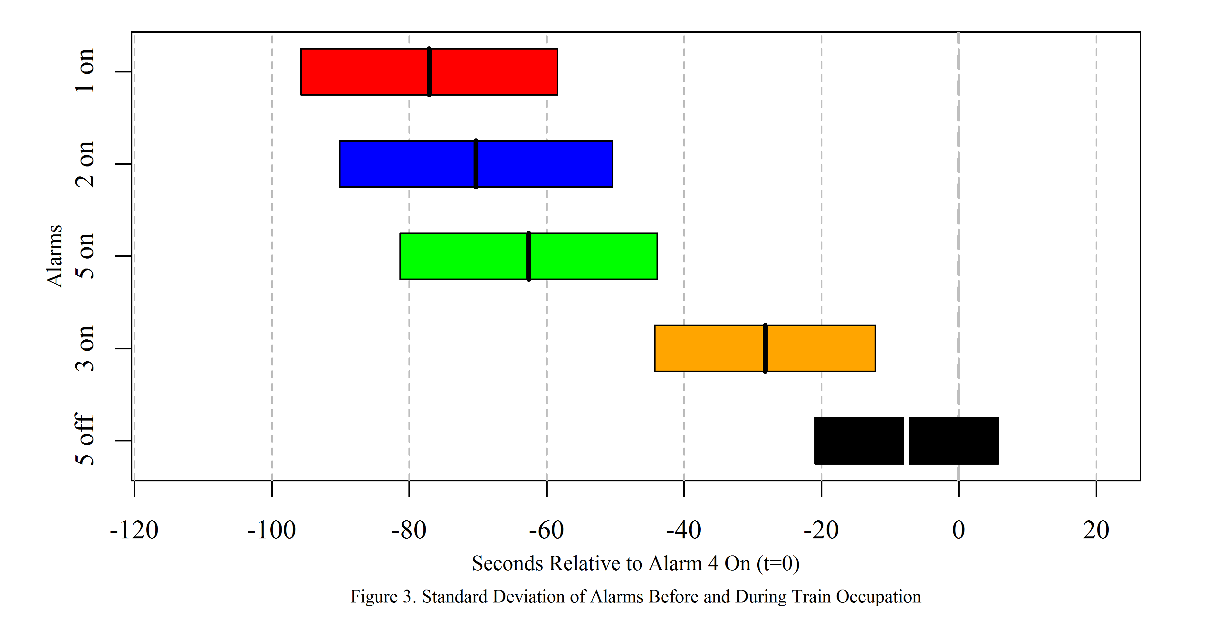
Rail Crossing Event Data Streams
Are alarms within one standard deviation?
Ped Clear
Veh Advance PE
Veh Green On
Gate Down
Veh Green Off
Seconds Relative to Train Arriving in Crossing
SE 11th Ave/SE Milwaukie Ave & SE Gideon St
Notes:
We can continue assessing the health of the interconnection, using the railroad’s standard deviation method. It’s understood that alarms vary, we just have to make sure that the worst case scenario is covered, and anything outside of that is within the rail operating guidelines.

Slide 12
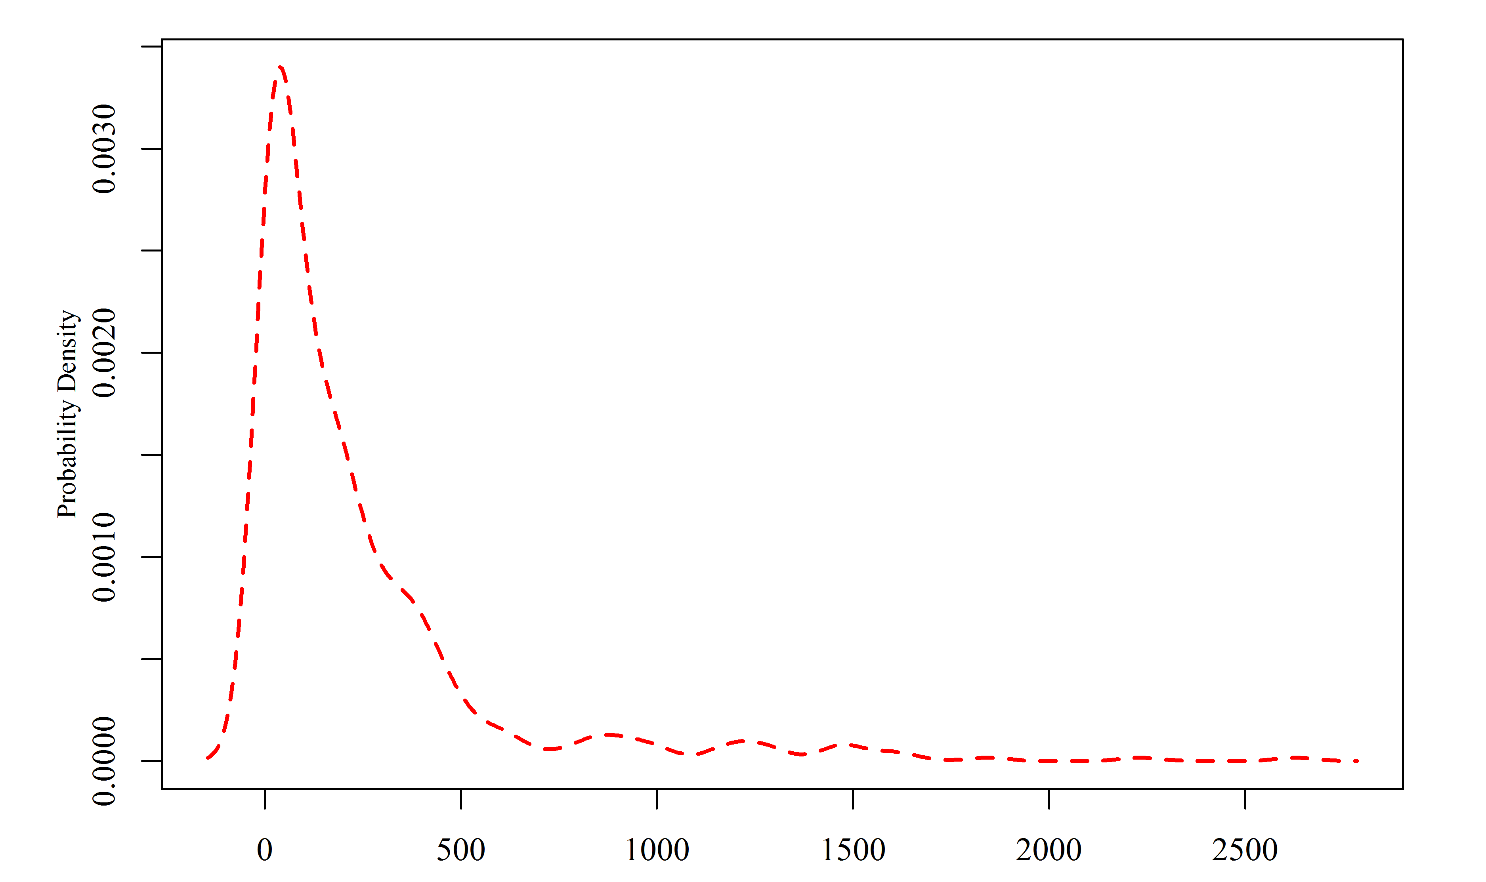
Rail Crossing Event Data Streams
How long are trains occupying the crossing?
Seconds Relative to Train Arriving in Crossing
SE 11th Ave/SE Milwaukie Ave & SE Gideon St
Seconds Relative to Train Arriving in Crossing

Slide 13
Summary
Data recording is very valuable, and satisfies FRA safety recommendations
Important to know when train is occupying the crossing
“Island circuit” is a relatively simple way to gather train crossing occupancy data
September 2015 – LRT!
Notes:
So that’s just a sneak peak at what we’re able to do with data logging and an island circuit at interconnected crossings…

Slide 14
Questions?
Adam Moore, PBOT (presenter)
adam.moore@portlandoregon.gov
Joint Rail Conference 2015
San Jose, CA
March 23-26
Paper #JRC2015-5774
Paul Zebell, PBOT
paul.zebell@portlandoregon.gov
Peter Koonce, PBOT
peter.koonce@portlandoregon.gov
Jon Meusch, Northwest Signal
jon.meusch@acttrafficsolutions.com

