Slide 1
Public health in long-range regional transportation plans: Guidance statements & performance measures
Patrick A. Singleton & Kelly J. Clifton
Portland State University – Portland, Oregon
Oregon ITE Winter Workshop
26 February 2015 – Portland, Oregon

Slide 2
Transportation → Health
Transportation
Public Health

Slide 3
Transportation → Health
Traffic safety
Traffic collisions cause injuries and fatalities.
Air quality
Motor vehicle emissions lead to respiratory illnesses.
Physical activity
Walking/bicycling help to mitigate obesity.
Accessibility
Transport affords access to education, employment, food, health care, social services, and recreation.

Slide 4
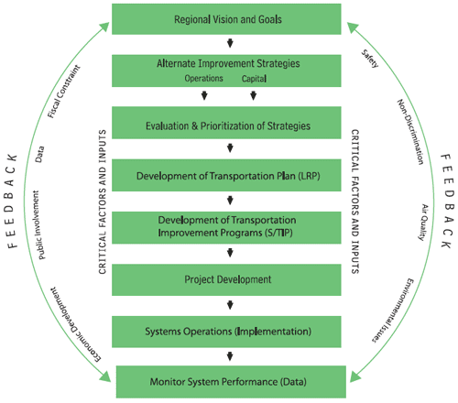
Long-range planning
Vision, goals, objectives
Evaluation metrics
Long-range transportation plan (RTP/LRTP)
Performance measures
http://www.planning.dot.gov/documents/briefingbook/bbook.htm

Slide 5
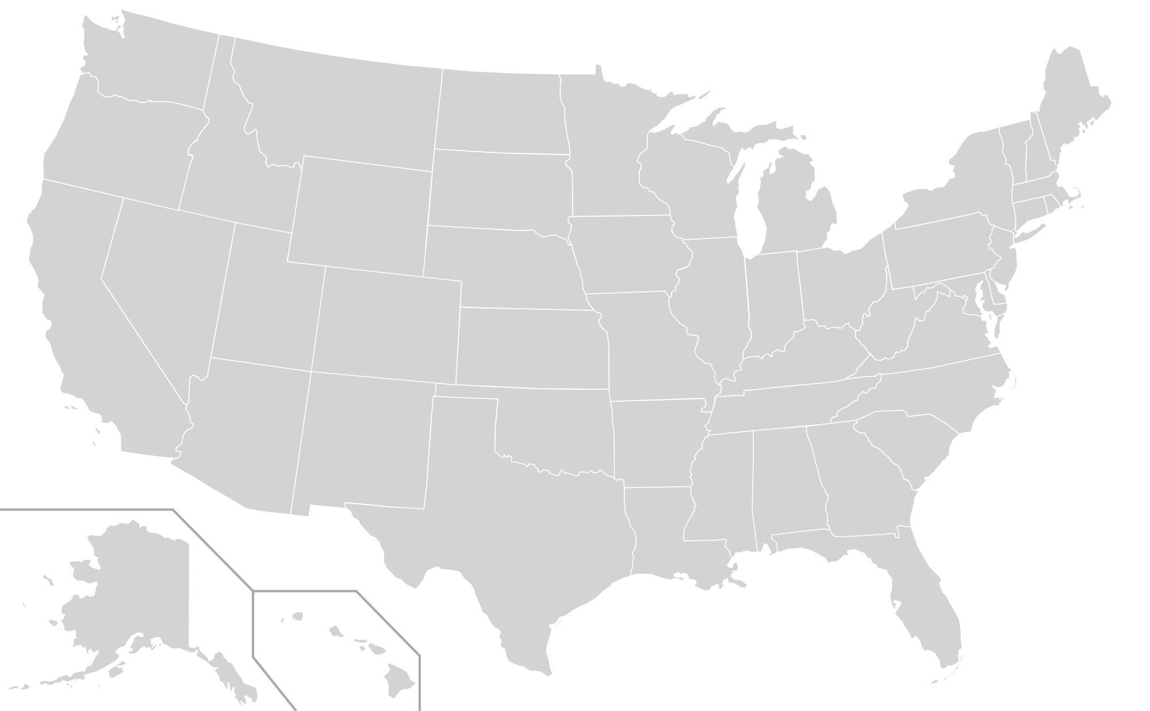
18 Large MPO Regions
Seattle
Portland
Detroit
Milwaukee
Cleveland
Chicago
Pittsburgh
San Francisco
Baltimore
Washington
Kansas City
St. Louis
Nashville
Memphis
Atlanta
San Antonio
Houston
Orlando
Miami

Slide 6
Method
Long-range transportation plans
Plan years 2009–2014; horizon years 2035/2040
Guidance statements
Vision, goals, objectives, policies, etc.
Performance measures
Measures, indicators, targets, etc.

Slide 7
Results
Public health
Safety
Air
Activity
Access
Examples:
[S]afe, comfortable and convenient options that support...physical activity, and minimize transportation-related pollution. (Portland)
[M]ultimodal transportation infrastructure and services that support active living and physical activity. (Baltimore)

Slide 8
Results
Public health
Safety
Air
Activity
Access
Examples:
Obesity rate. (Atlanta) Average body mass index. (Seattle)
Annual traffic injury and fatality totals and rates. (Kansas City)
Daily minutes of walking/bicycling for transportation. (San Francisco)
% population/employment within ¼ mile of transit service. (Orlando)

Slide 9
Summary of findings
Incomplete views of transportation → health
Most plans guided by safety and accessibility
Air quality concerns may be under-represented
Regional plan policy foci guided by national policy
Performance measures ~ related to policy guidance

Slide 10
Potential strategies
Adopt health-related guidance statements
Adopt health-related performance measures
Advance travel modeling and health impact assessment methods
Improve public participation and environmental justice efforts

Slide 11
Acknowledgements
Patrick A. Singleton patrick.singleton@pdx.edu
Kelly J. Clifton, PhD kclifton@pdx.edu
https://wiki.cecs.pdx.edu/pub/ItsWeb/TrbConferences/15-2169 _Singleton-Clifton_Incorporating-public-health_revised.pdf

Slide 12
Summary of MPO LRTPs
Region | Metropolitan planning organization (MPO) | 2010 pop. (million) | Plan year | Horizon year | Walk/bike modelsª
Atlanta, GA | Atlanta Regional Commission (ARC) | 4.8 | 2014 | 2040 | III
Baltimore, MD | Baltimore Regional Transportation Board (BRTB) | 2.7 | 2011 | 2035 | II
Chicago, IL | Chicago Metropolitan Agency for Planning (CMAP) | 8.4 | 2010 | 2040 | II
Cleveland, OH | Northeast Ohio Areawide Coordinating Agency (NOACA) | 2.1 | 2013 | 2035 | III
Detroit, MI | Southeast Michigan Council of Governments (SEMCOG) | 4.7 | 2013 | 2040 | I
Houston, TX | Houston-Galveston Area Council (H-GAC) | 5.9 | 2010 | 2035 | I
Kansas City, MO | Mid-America Regional Council (MARC) | 1.9 | 2010 | 2040 | I
Memphis, TN | Memphis Urban Area Metropolitan Planning Organization | 1.1 | 2012 | 2040 | II
Miami, FL | Miami-Dade Metropolitan Planning Organization | 2.5 | 2009 | 2035 | II
Milwaukee, WI | Southeastern Wisconsin Regional Planning Commission (SEWRPC) | 2.0 | 2010 | 2035 | II
Nashville, TN | Nashville Area Metropolitan Planning Organization | 1.4 | 2010 | 2035 | I
Orlando, FL | MetroPlan Orlando (METROPLAN) | 1.8 | 2010 | 2030 | I
Pittsburgh, PA | Southwestern Pennsylvania Commission (SPC) | 2.6 | 2011 | 2040 | I
San Antonio, TX | San Antonio–Bexar County Metropolitan Planning Organization | 1.8 | 2009 | 2035 | III
San Francisco, CA | Metropolitan Transportation Commission (MTC) | 7.2 | 2013 | 2040 | III
Seattle, WA | Puget Sound Regional Council (PSRC) | 3.7 | 2014 | 2040 | III
St. Louis, MO | East-West Gateway Council of Governments (EWGCOG) | 2.6 | 2011 | 2040 | III
Washington, DC | National Capital Region Transportation Planning Board (TPB) | 5.0 | 2012 | 2040 | II
Portland, OR^{b} | Metro | 1.5 | 2014 | 2040 | III
ª Tier I models do not include walking or bicycling. Tier II models group walking and bicycling into a single non-motorized mode. Tier III models include both walking and bicycling in the mode choice stage.
^{b} Portland, OR was used to develop the screening and search terms.

Slide 13
Summary of Results
MPO region | Guidance statements |  |  |  |  | Performance measures
 | Public health | Health components |  |  |  | Public health | Health components
 |  | Safety | Air | Activity | Access |  | Safety | Air | Activity | Access
Atlanta, GA | ✓ | ✓ |  | ✓ | ✓ | ✓ | ✓ | ✓ | ✓ | ✓
Baltimore, MD | ✓ | ✓ | ✓ | ✓ | ✓ |  | ✓ | ✓ |  | ✓
Chicago, IL | ✓ | ✓ |  |  | ✓ |  |  |  |  | ✓
Cleveland, OH | ✓ | ✓ |  |  | ✓ | – | – | – | – | –
Detroit, MI |  | ✓ |  | ✓ | ✓ |  | ✓ | ✓ |  | ✓
Houston, TX |  | ✓ |  |  | ✓ |  | ✓ | ✓ |  | ✓
Kansas City, MO | ✓ | ✓ | ✓ | ✓ | ✓ |  | ✓ | ✓ | ✓
Memphis, TN | ✓ | ✓ | ✓ |  | ✓ |  | ✓ |  |  | ✓
Miami, FL |  | ✓ | ✓ |  | ✓ |  | ✓ | ✓ |  | ✓
Milwaukee, WI |  | ✓ | ✓ |  | ✓ | – | – | – | – | –
Nashville, TN | ✓ | ✓ | ✓ | ✓ | ✓ | – | – | – | – | –
Orlando, FL |  | ✓ | ✓ |  | ✓ |  | ✓ | ✓ |  | ✓
Pittsburgh, PA | ✓ | ✓ |  |  | ✓ | – | – | – | – | –
San Antonio, TX |  | ✓ | ✓ |  | ✓ | – | – | – | – | –
San Francisco, CA | ✓ | ✓ | ✓ | ✓ | ✓ | ✓ | ✓ | ✓ | ✓ | ✓
Seattle, WA | ✓ | ✓ | ✓ | ✓ | ✓ | ✓ |  | ✓ | ✓
St. Louis, MO |  | ✓ |  |  | ✓ | – | – | – | – | –
Washington, DC |  | ✓ | ✓ |  | ✓ | – | – | – | – | –
Portland, ORª | ✓ | ✓ | ✓ | ✓ | ✓ |  | ✓ | ✓ | ✓ | ✓
Totals | 10 | 18 | 11 | 7 | 18 | 3 | 9 | 9 | 4 | 9
– Performance measures not included in plan.
ª Portland, OR was used to develop the screening and search terms; results are not included in totals.

