Slide 1
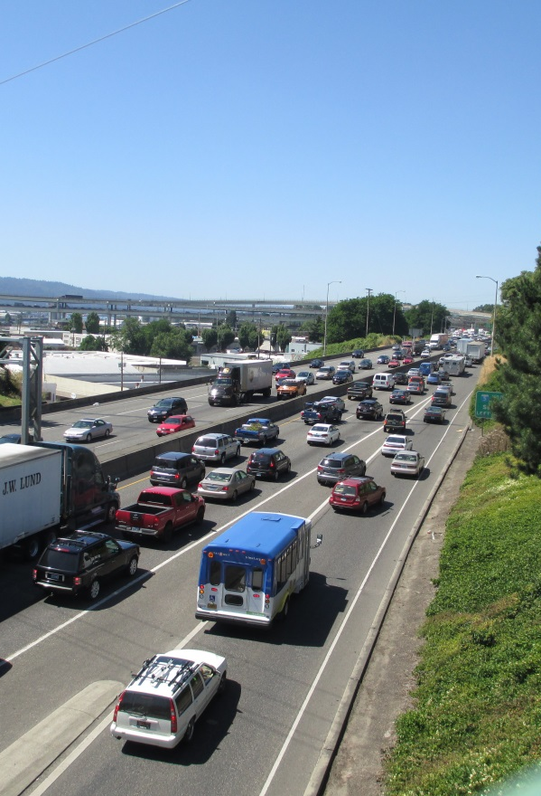
I5-Broadway Weilder –
Safety Analysis
Jon Makler, ODOT
Miranda Wells, HDR
OR ITE Winter Workshop
February 26^{th,} 2015

Slide 2
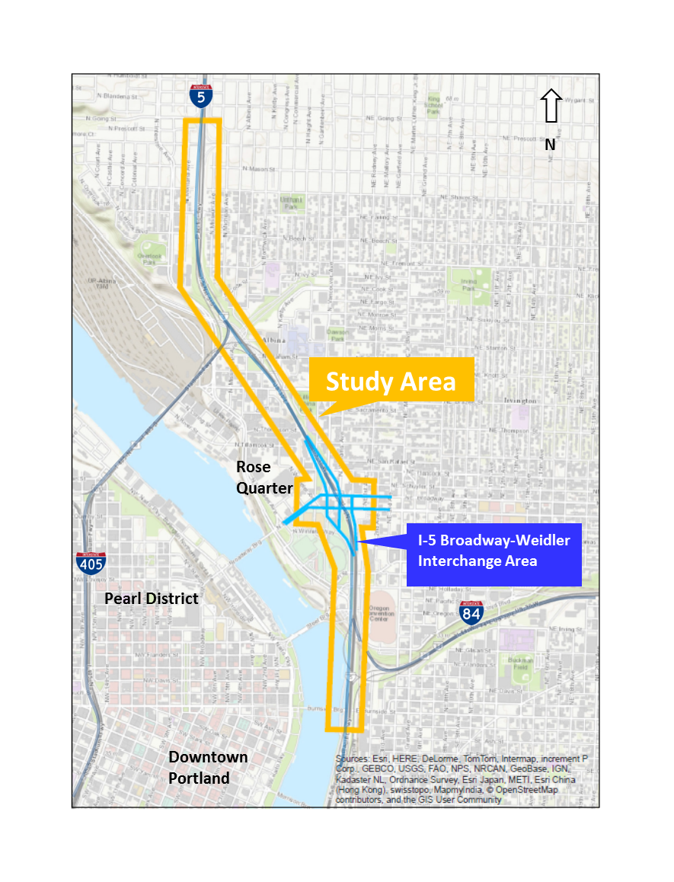
Study Area
I-5 Northbound/Southbound
  Going to Morrison Ramps
Arterial Network
  Broadway and Weilder
  I-84 Eastbound Just past Grand Ramp

Slide 3
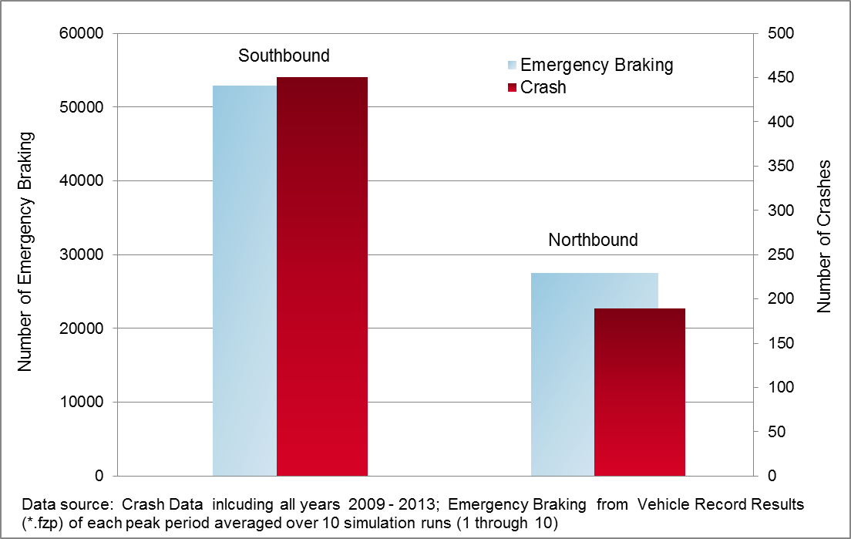
Existing Crashes Compared to Existing Calibrated VISSIM Results
Emergency Braking = Deceleration Rate Greater than 14.8 ft/sec

Slide 4
Emergency Braking
Southbound Event Analysis
 | Going to Broadway | Broadway to Morrison | Total
A1 | 55,529 | 12,818 | 63,348
A2 | 68,106 | 13,289 | 81,305
B1 | 13,078 | 16,759 | 29,837
B2 | 18,203 | 16,306 | 34,509
C1 | 19,391 | 7,209 | 26,600
C2 | 25,985 | 9,826 | 35,810
c1 | 18,170 | 7,183 | 25,352
c2 | 27,890 | 10,315 | 38,206
In the no-build scenario (A2), there are roughly 80,000 events.
Most (84%) events occur north of Broadway.
In the “facility plan” scenario (B2), there are roughly 35,000 events SB (57% reduction).
The basic braid (c2) sees more events SB (38,000) compared to B2.
The “double braid” scenario (C2) has 36,000 events SB – in between B2 and c2.
Adding the two-lane flyover makes each scenario safer SB.
All the “build” scenarios reduce SB events north of Broadway by more than 60%.
Only the braid options reduce SB events south of Broadway by a significant degree and the double-flyover makes a big difference.

Slide 5
Why Emergency Braking?
Closely Spaced Interchanges and bottlenecks spilling back into the study area are not accounted for in deterministic safety analysis.
What are the Results Showing?
Overall significant reductions in emergency braking instances for all the Build Options
Adding a two lane flyover for the braided options improves safety on I-5

Slide 6
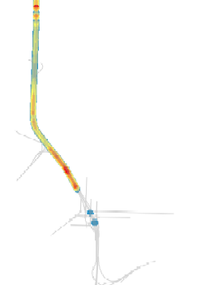
Heat Maps
Southbound visual representation of data

Slide 7
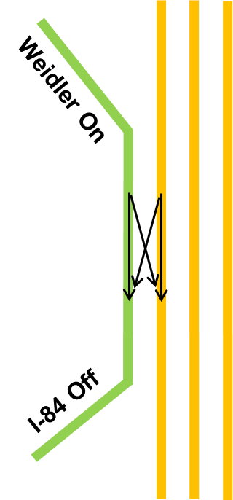
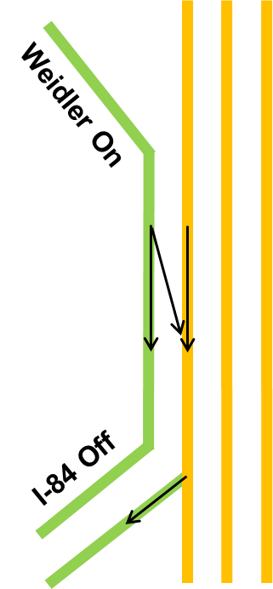
Weilder – I-84 Weave

Slide 8
Contact Information:
Miranda Wells, PE
Traffic Engineer
HDR miranda.wells@hdrinc.com
Questions?

